Slide 1
K2
Synthetic marijuana first appeared in Europe in early 2000s and in the US by 2008.
Dr. John Huffman (Clemson University) started developing synthetic cannabinoids to aid in the research of MS, HIV/AIDS and chemotherapy.

Slide 2
K2
Late 2000’s, two of Dr. Huffman’s compounds were being sold in Germany as marijuana alternatives.
JWH (John William Huffman)is the most widely used series of synthetic, the most noted is JWH-018.
HU (Professor Rapheal Mechoulam from the Hebrew University) was first synthesized in 1988 and HU-210 was created. 100x more potent than natural THC.

Slide 3
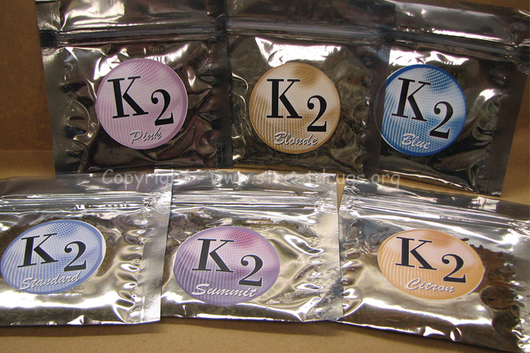
K2

Slide 4
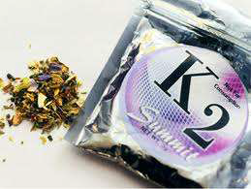
K2 Facts
Falsely advertised as “safe”, “natural” and “legal”
Sold in tobacco shops and over the internet as an “herbal incense”, “plant food” or “potpourri”
Makers disguise packages and avoid law enforcement by labeling package- “not for human consumption”

Slide 5
K2 Facts
Some of the chemicals used have not been completely identified and the effects on the human body and mind are unknown.
Synthetic marijuana has appearance of dried leaves and sold in small, silvery plastic bags.

Slide 6
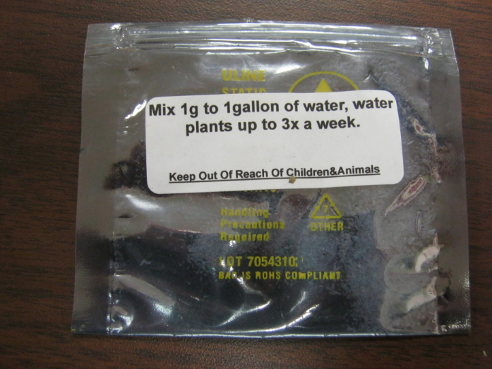

Slide 7
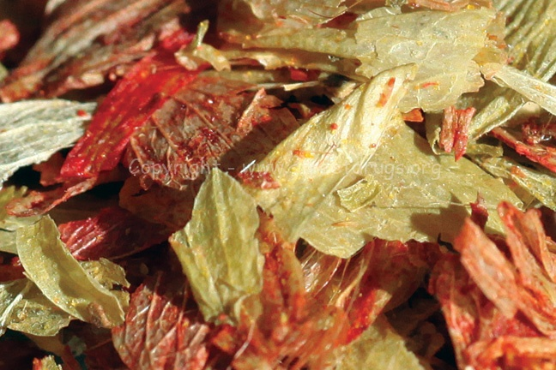
K2
Synthetic chemical is sprayed on
Leaves. Dried and packaged. No
regulations or standards. Each
could be different and dangeroud to user

Slide 8
K2 Facts
It can be smoked in rolled joints, pipes or e-cigarettes.
Some users make into tea or use in brownie recipes.
Calls to poison control centers related to K2 use increased in the US by almost 80 percent between 2010 and 2012.
Does not show up on drug test.
Each bag could contain a different mix of synthetic chemical substances due to no regulations or standards.

Slide 9
Common Names
Silver Spice
Diamond Spice
PEP Spice
Fire N Ice
K2
Algerian Blend
Blaze
Bliss
Chill
Dream
Fake Pot
Lava
Mr. Smiley
Scooby Snacks
Skunk
Spice XXX
Silent Black
Tai Fun
Wicked
Zen

Slide 10
Short-Term Effects
On The Mind
Unresponsiveness
Loss of Consciousness
Extreme Anxiety
Delusions
Hallucinations
Potential Suicide
On The Body
Nausea/Vomiting
Heavy Sweating
Rapid Heart Rate
High Blood Pressure
Heart Attack
Convulsions

Slide 11
Long Term Effects
Long term effects are still not fully known but they can be life threatening.
Withdraw symptoms can include: cravings, nightmares, headaches, insomnia, diarrhea and vomiting.
Users have experienced forgetfulness, confusion and paralysis.

